Slide 1

HDFS Log Analysis Using ELK Stack
Presented by-
Aarya Parikh (40262787)
Avaneesh Kanshi (40273760)
Apurba Das (40263612)
Pankaj Sharma (40269802)
Smridhi Verma (40266036)

Slide 2
PROBLEM STATEMENT
HDFS Log Volume: HDFS logs are generated from various operations, including file system usage and diagnostic processes. These logs create a large volume of data, making manual analysis nearly impossible due to the overwhelming "noise."
Challenges: Analyzing these logs is critical for diagnosing issues, improving system performance, and maintaining high availability in distributed architectures. However, this process is time-consuming and complex.
Existing Gaps: Current approaches face significant limitations, such as the inability to process logs in real time, lack of scalability, and insufficient actionable insights. As a result, the sensory systems used in distributed setups often fall short of meeting operational demands.
Need: There is a clear requirement for a user-friendly, automated system that can handle large volumes of HDFS logs. Such a system should be capable of scaling efficiently, providing visual insights, and enabling easy search functionality. This would enhance performance, simplify diagnostics, and help reduce faults in the system.

Slide 3
INTRODUCTION
The Hadoop Distributed File System (HDFS) plays a vital role in managing files across distributed systems with high storage capacities. It generates a variety of logs—capturing events such as file creation, block replication, and system diagnostics. These logs are essential for identifying and fixing issues, optimizing resource allocation, and maximizing system uptime.
However, the sheer volume of HDFS logs presents significant challenges. Logs are distributed across various nodes and processes, making manual analysis nearly impossible. Troubleshooting and tuning become cumbersome without a streamlined system. To address this, I am leveraging the ELK stack—Elasticsearch, Logstash, and Kibana—an open-source solution for processing and visualizing logs effectively.
Project Goals and Approach The primary goal of this project is to build a scalable log analysis system that offers real-time insights, fault tolerance, and robust performance. To achieve this:
Redis serves as an asynchronous processing layer, enabling efficient data handling.
NGINX is utilized for resource query allocation, ensuring smooth operations even with large datasets.
This approach automates log analysis, simplifying resource management in a distributed environment. By visualizing logs and offering actionable insights in real time, the system enhances overall performance and minimizes operational complexity.

Slide 4
Dataset OVERVIEW
This project uses the HDFS_v3_TraceBench dataset from Loghub and TraceBench, which provides logs collected from a real IaaS environment. The dataset includes over 370,000 traces from 364 files, representing 180+ hours of data collection under various scenarios, including normal operations, different cluster scales, and fault-injected conditions.
The dataset focuses on four primary log types: trace logs, operation logs, edge logs, and event logs, all in CSV format. These logs document key HDFS activities like file creation, data replication, and system performance metrics, enabling detailed analysis through the ELK stack. This structured dataset highlights the effectiveness of ELK in managing and analyzing large-scale distributed system logs.

Slide 5
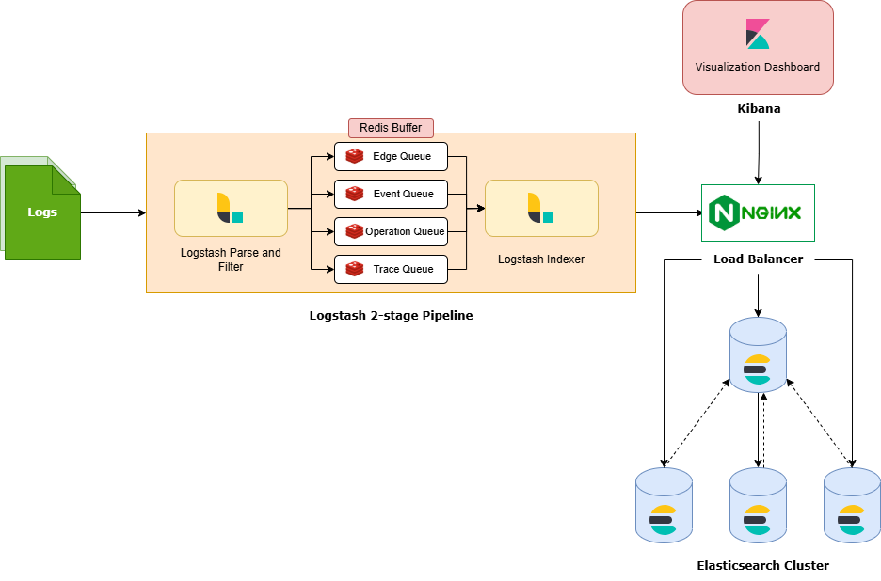
SYSTEM ARCHITECTURE

Slide 6
METHODOLOGY
Log Collection and Parsing The final stage of the log management process involves collecting and parsing HDFS logs. These raw logs, stored in CSV format, are managed using MongoDB. Each log entry includes timestamps to provide detailed insights into operations and activities performed within the system.
Asynchronous Buffering with Redis Redis acts as a buffer to manage the flow of logs through asynchronous operations, preventing data loss during log shredding. This creates "breathing space" for handling different log types, ensuring efficient bulk transfers and uninterrupted data flow.
Indexing in Elasticsearch After log shredding, the processed HDFS logs are indexed in Elasticsearch. Data is stored using RAID configurations with replicas, ensuring redundancy and autonomy, which enhances fault tolerance and scalability.
Visualization in Kibana Indexed data is visualized using Kibana dashboards. These dashboards provide key metrics, such as time spent on tasks, host-related delays, and overall system performance, offering actionable insights for optimization.
NGINX for Load Balancing NGINX ensures high availability of Kibana by distributing query workloads across multiple Elasticsearch nodes. This prevents system bottlenecks and maintains a seamless user experience, even under high loads.
This integrated approach ensures smooth log management, real-time insights, and high system performance, making it ideal for distributed architectures like HDFS.

Slide 7
Results
It was the implementation of the ELK stack to the analysis of HDFS logs that proved the usefulness of such an approach on big volumes of data, allowing for system performance analysis. The points of the relevance of the findings are the following:
Task Duration Analysis- Based on histograms, some operations such as large file writes were expected to take less time than is actually the case.
Delay Analysis- Some of the bar charts shed light on the delays experienced in the processes of the creation of files which could be attributed to congestion or bottlenecks in the data resources and the pipelines.
Host Level Analysis- From the pie charts it could be seen that there was uneven distribution of events in the different nodes of the cluster. This signaled less used nodes and indicated potential areas for improvement in load balancing.
Scalability and Fault Tolerance- Utilization of the master-slave structure of the clusters of Elasticsearch secured reliability against node failures.The Redis buffer provided a means of carrying out data processing tasks out of sequence making it possible to easily and cleanly the subsequent tasks without interrupting them.
Kibana Dashboard

Slide 8
CONCLUSION
The project to automate HDFS log analysis using the ELK stack has been a success. The system now provides real-time performance monitoring by leveraging Logstash for data input, Redis for buffering, Elasticsearch for storage, and Kibana for visualization. Key achievements include:
Time and Effort Savings: Automation of log retrieval, analysis, and reporting.
High Availability: Distributed configuration ensures redundancy and fault tolerance.
Actionable Insights: Detecting bottlenecks, prioritizing fixes, and optimizing resource usage.
This work demonstrates the ELK stack's effectiveness for managing large-scale log data, ensuring reliable operability and enhanced system performance.

Slide 9
REFERENCES
[1] Loghub Dataset. 2023. Loghub: A Large Collection of System Log Datasets for AI-driven Log Analytics. https://github.com/logpai/loghub.
[2] Mtracer. 2014. TraceBench: An Open Data Set for Trace-oriented Monitoring. https://mtracer.github.io/TraceBench.
[3] Jingwen Zhou, Zhenbang Chen, Ji Wang, Zibin Zheng, and Michael R. Lyu. 2014. TraceBench: An Open Data Set for Trace-oriented Monitoring. In Proceedings of the 6th IEEE International Conference on Cloud Computing Technology and Science (CloudCom).
[4] Jieming Zhu, Shilin He, Pinjia He, Jinyang Liu, and Michael R. Lyu. 2023. Loghub: A Large Collection of System Log Datasets for AI-driven Log Analytics. In Pro-ceedings of the IEEE International Symposium on Software Reliability Engineering (ISSRE).

Slide 10

Thank You

